Slide 1

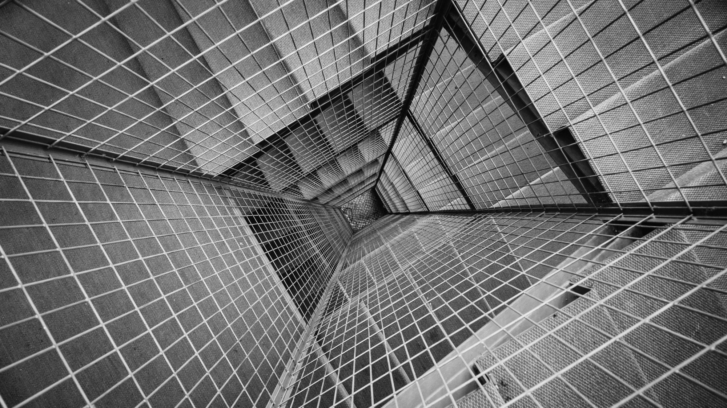
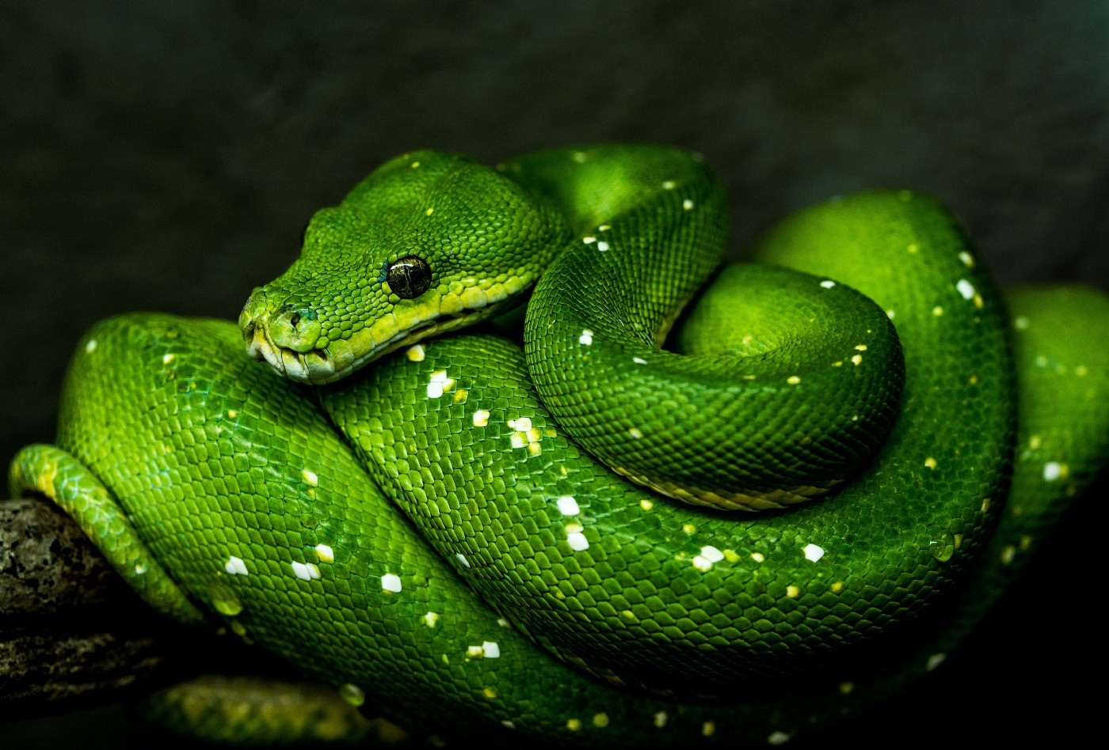
DATA ANALYTICS USING PYTHON
SUBTITLE GOES HERE

Slide 2
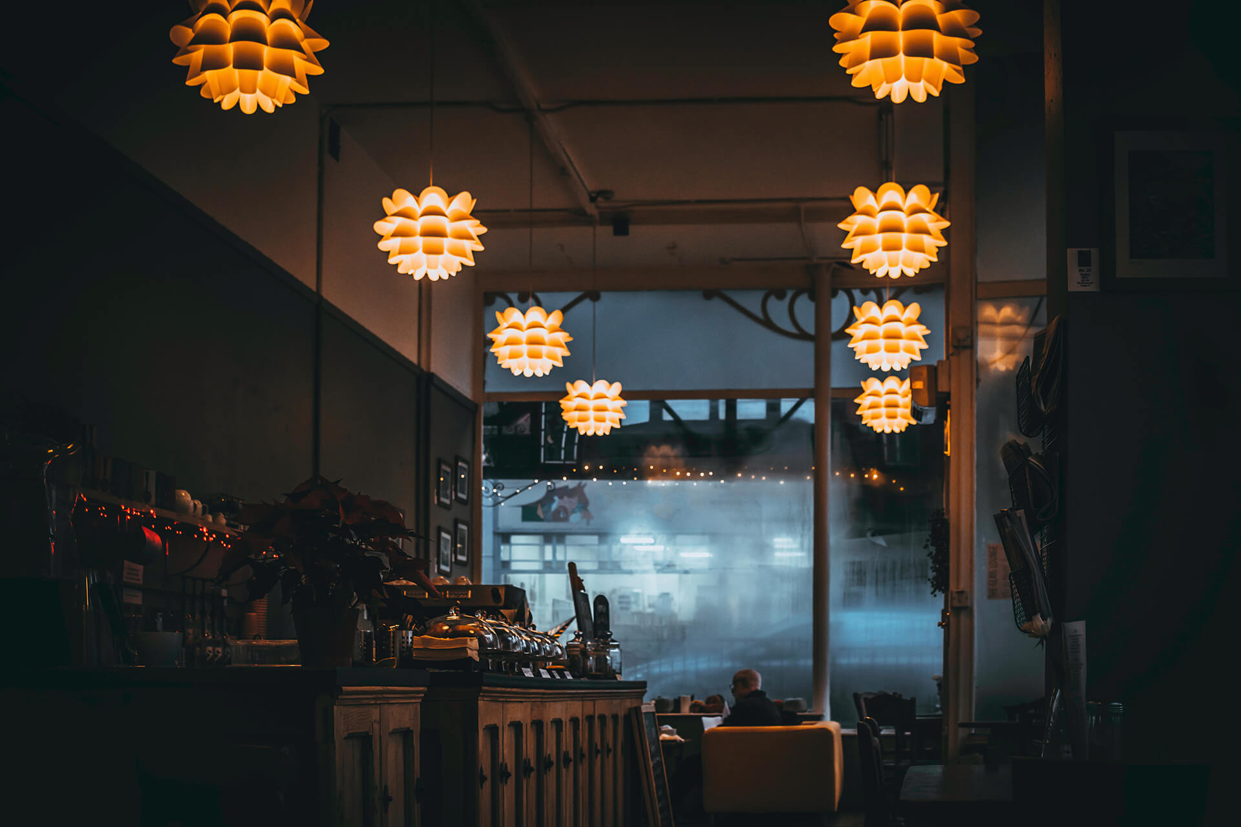
RESTAURENT MANAGEMENT SYSTEM USING PYTHON
RESTAURENT MANAGEMENT SYSTEM USING PYTHON
RESTAURENT MANAGEMENT SYSTEM USING PYTHON
ATCHAYA G
120011152730
ATCHAYA G
120011152730

Slide 3
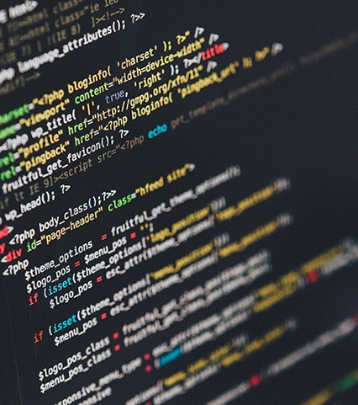
Flask
FRONT END
HTML
Bootstrap
BACK END
Firebase

Slide 4
REASON TO USE FIREBASE:
1.Userfriendly
2.Light weight
3.Interactive dashboard

Slide 5

reason to use python flask:
1.Light weighted framework
2.Easy to blend the app flow
3.Adopt the changes made in future

Slide 6
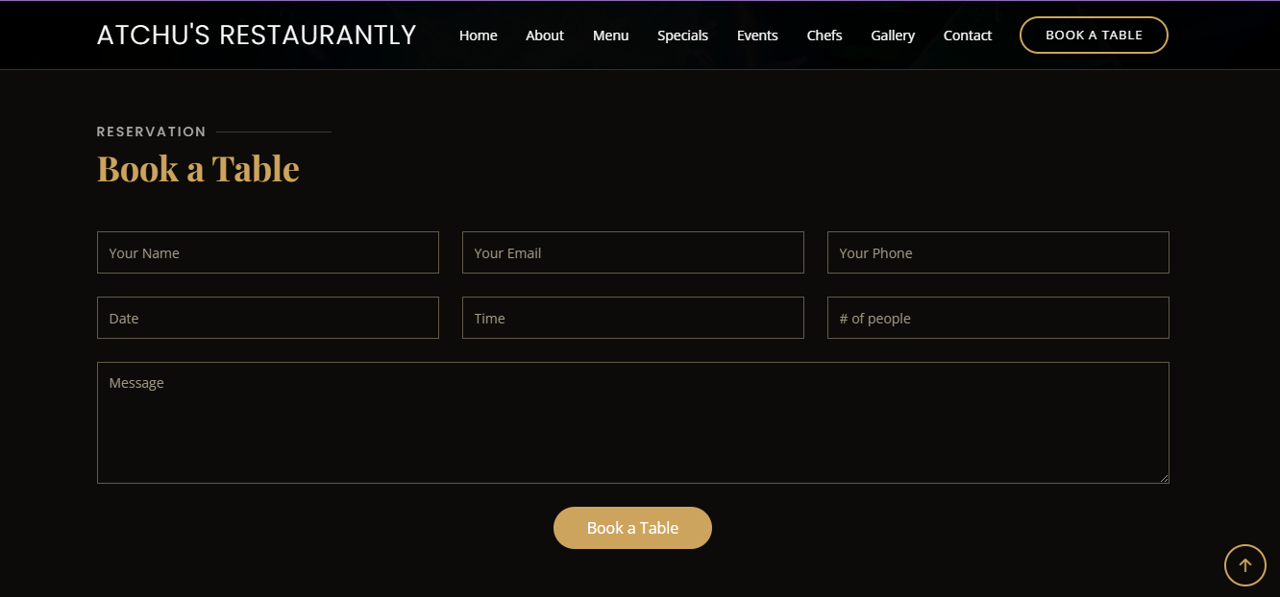
where we use python:
1.Book a slot form module
2.data fetched by python-flask script and moved to the database(firebase)
3.we have see the fetched data in the firebase dashboard.

Slide 7
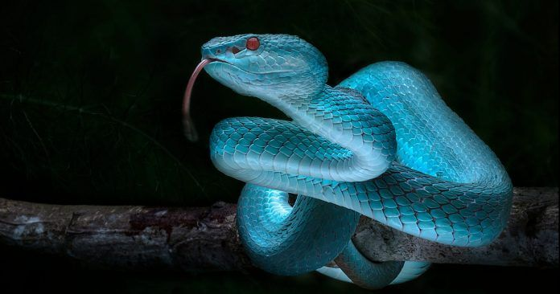
x
SEE WEBSITE
http://ec2-65-2-181-127.ap-south-1.compute.amazonaws.com:5000/
http://surl.li/luti
FIREBASE
https://console.firebase.google.com/?pli=1

Slide 8
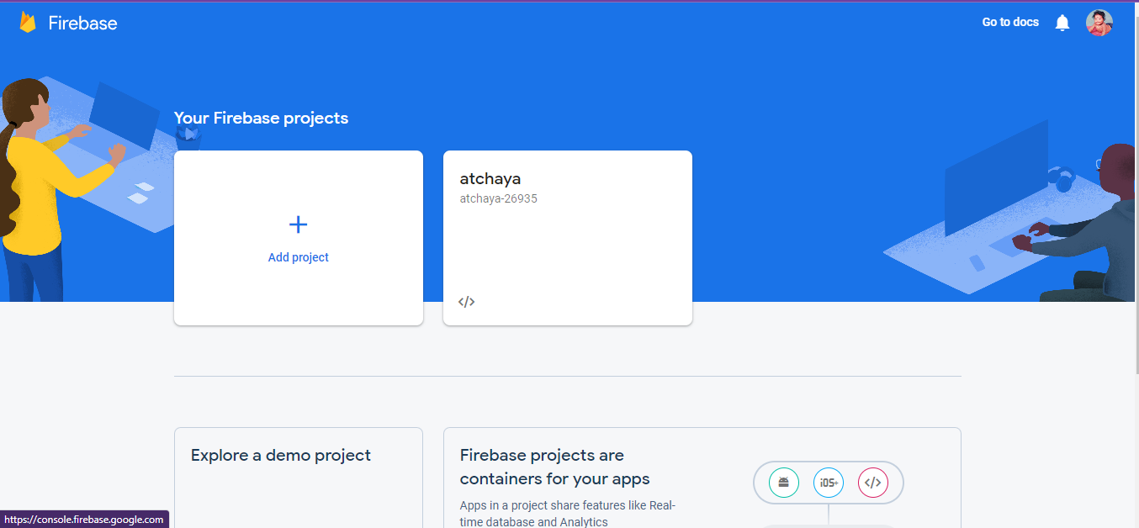

Slide 9
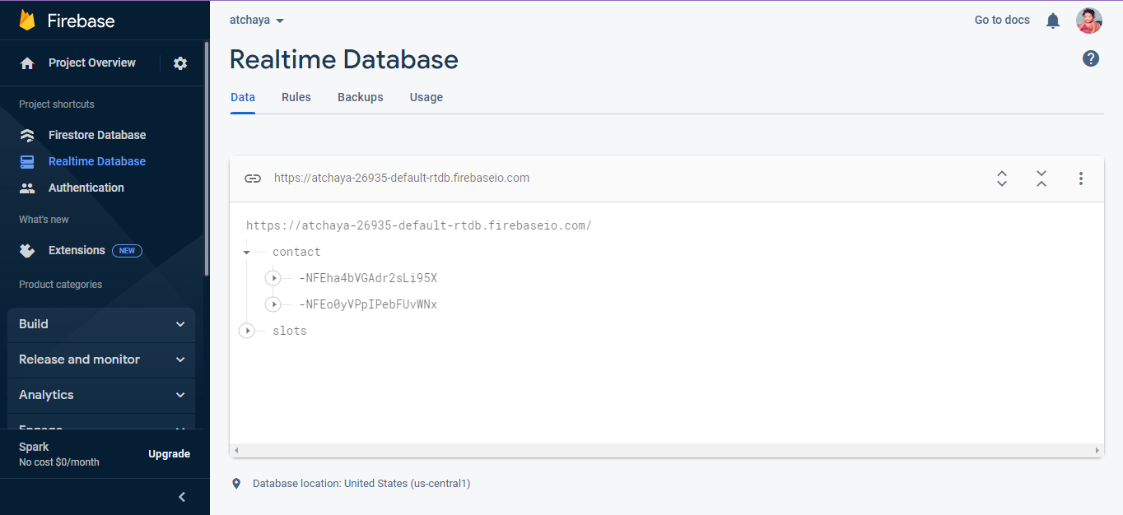

Slide 10




THANK YOU
ATCHAYA G
9360299276
atchayaga@gmail.com

